Slide 1
Swarm Intelligence - Ant Colony Optimization

Slide 2
Swarm Intelligence
Any attempt to design algorithms or distributed problem-solving devices inspired by the collective behavior of social insect colonies and other animal societies
It is an artificial intelligence (AI) technique based on the collective behavior in decentralized, self-organized systems
Generally made up of agents who interact with each other and the environment
No centralized control structures
Based on group behavior found in nature

Slide 3
Swarm Intelligence
Insects have a few hundred brain cells
However, organized insects have been known for:
Architectural marvels
Complex communication systems
Resistance to hazards in nature
In the 1950’s E.O. Wilson observed:
A single ant acts (almost) randomly – often leading to its own demise
A colony of ants provides food and protection for the entire population

Slide 4
Agents - Examples
Swarm of Bees - Bees
Ant colony - Ants
Flock of birds - Birds
Traffic - Cars
Crowd - Humans
Immune system - Cells and Molecules

Slide 5
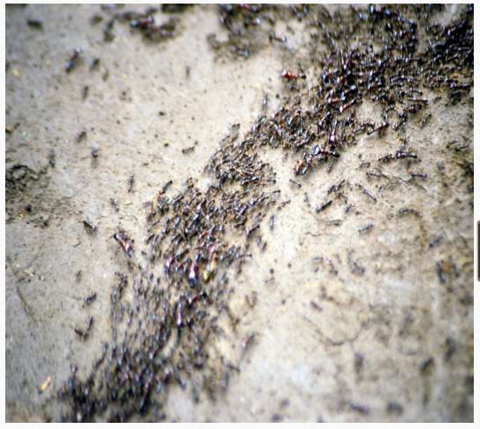
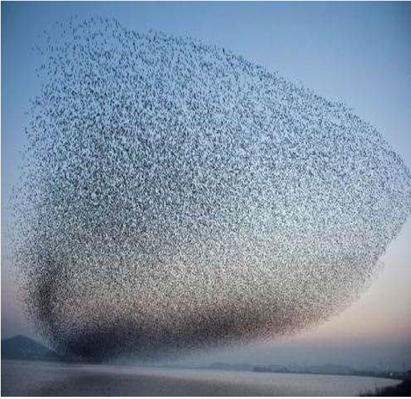
Swarm Intelligence
Ant colony Flock of birds

Slide 6

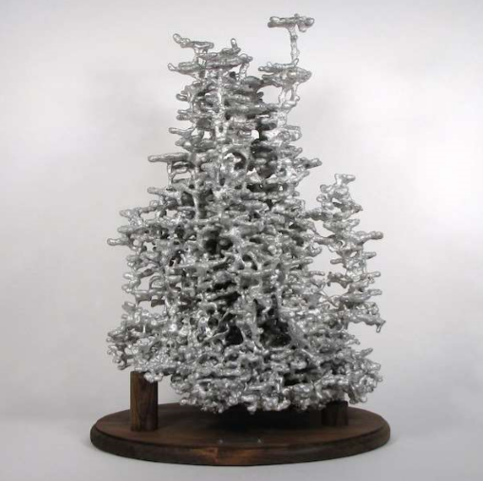

Real Ant nests taken from the Earth

Slide 7
Swarm Intelligence
This huge Ant colony Concrete, that has been Excavated from earth in several weeks.
This Colony has roads with shortest path between every two points.
Characteristics
Composed of many individuals
Individuals are homogeneous
Local interaction based on simple rules
Self-organization

Slide 8
Four Ingredients of Self Organization
Positive Feedback
Negative Feedback
Amplification of Fluctuations – randomness
Reliance on multiple interactions

Slide 9
Swarm Intelligence - Example
Ant Colony Optimization
Every single insect in a social insect colony seems to have its own agenda, and yet an insect colony looks so organized.
The seamless integration of all individual activities does not seem to require any supervisor.
For Example there is in one colony different type of workers:
Leafcutter Ants
Weaver Ants
Army Ants

